Slide 1
Singleton Design Pattern
Sai Sandeep -61
Prudhvi Sai Suggala-51
Hemanth Kumar Reddy-11
Snehal Vantasala-55

Slide 2
Singleton
Meaning:
A set with exactly one element (mathematics).
A design pattern used in object-oriented programming to permit no more than one instance of a class (Software Engineering).

Slide 3
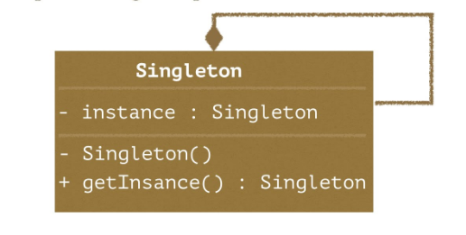
Singleton Pattern
Ensure that a class has only one instance and provide global point of access to it.

Slide 4
Implementation
Make sure that there is only one instance restrict construction- make constructor private and let the class manage its instance.
Provide a global point of access: a static method to get the sole instance.

Slide 5
Uses of Single Pattern
The abstract factory, builder, and prototype patterns can use Singletons in their implementation.
State objects are often Singletons.
Singletons are often preferred to global variables.

Slide 6
Implementation
Remember
Ensure that only one instance of the singleton ever exists
Provide global access to that instance
Declaring all constructors of the class to private .
providing a static method that returns a reference to the instance .

Slide 7
Sample lazy implementation
public final class Singleton {
private static Singleton instance = null;
private Singleton() {}
public static synchronized Singleton getInstance()
{
if (instance == null)
instance = new Singleton(); //lazy intilization
return instance;
}
}

Slide 8
public final class Singleton {
private static final Singleton INSTANCE = new Singleton();
private Singleton() {}
public static Singleton getInstance()
{
return INSTANCE;
}
}

Slide 9
public class Satellite {
A static field to hold the instance. But we do not need it if you do not use Lazy initialization
private static Satellite _instance;
Always close the access to constructors
private Satellite(){}
private static class SatelliteHelper{
private static final Satellite _innerInstance = new Satellite();
}
All the classes should use this method to get the instances.
public static Satellite getSatellite(){
return SatelliteHelper._innerInstance;
}
Use this method for lazy initialization but recommended to use the helper class way
public static Satellite getLazySatellite(){
if(_instance == null){
_instance = new Satellite();
}
return _instance;
}
}

Slide 10
public class Exec {
public static void main(String[] args) {
for (int i = 0; i < 5; i++) {
System.out.println(Satellite.getSatellite().hashCode());
}
}
}

